Slide 1


Introduction to
Robotic Process Automation
Game Requirements
Recommedation System
220701199
Prasanth D
N.Dhuraimurugan
Asst.Professor & Computer Science and Engineering

Slide 2
Abstract
This project introduces a "Game Requirements Recommendation System" that utilizes UiPath automation and the RAWG API to simplify and streamline retrieving and managing PC game requirements. The system inputs game names, fetches game details via the RAWG API, deserializes the JSON response, and stores the data systematically in an Excel file. This tool aims to provide users with easy access to technical specifications, ensuring a seamless gaming experience.

Slide 3
Need for the Proposed System
Modern gaming often requires up-to-date hardware and software compatibility checks. Manually searching for system requirements is time-consuming and prone to error. The proposed system automates this process, making it faster, accurate, and accessible, catering especially to gamers and PC enthusiasts who frequently need to check compatibility before purchasing games.

Slide 4
Advantages of the Proposed System
Automates repetitive tasks, minimizing manual efforts.
Ensures error-free and standardized data storage.
Simplifies the process of managing requirements for multiple games.
Offers flexibility for scaling to other game-related information.
Creates a user-friendly system with accessible outputs like Excel files.

Slide 5
Literature Survey
Paper 1: "API Integration for Game Data Retrieval"
Advantages: Provides accurate, real-time game information; simplifies data collection.
Disadvantages: Dependent on API availability and rate limits.
Paper 2: "RPA in Data Management Systems"
Advantages: Automates repetitive tasks; reduces manual errors.
Disadvantages: Requires maintenance for API updates; initial setup is complex.

Slide 6
Main Objective
The main goal of the system is to develop an automated tool that simplifies the retrieval of game system requirements using UiPath. By integrating the RAWG API, the system provides users with a hassle-free way to fetch, process, and store game details in a structured Excel format, eliminating the need for manual data entry and search efforts.So that the user could use these information for his coding as datasets or input type.
This data is mostly , could be used by a person who wants to build PC according to games he wishes to play

Slide 7
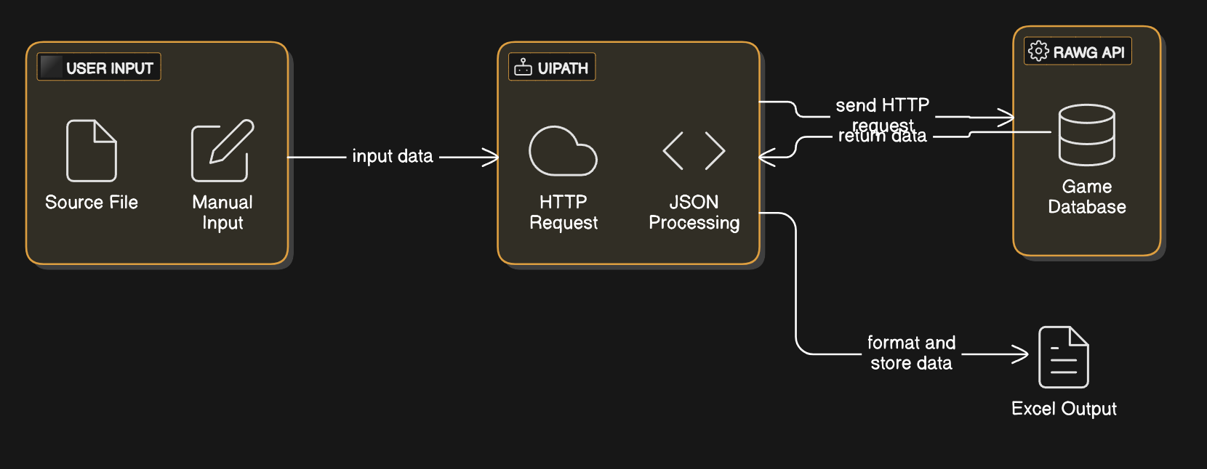
Architecture

Slide 8
System Requirements
Hardware:
CPU: Intel i3 or equivalent for optimal performance.
RAM: Minimum 4 GB for smooth UiPath operation.
Storage: At least 256 GB SSD to store application files and outputs.
Software:
UiPath Studio for workflow automation.
RAWG API key for accessing game data.
Microsoft Excel for data storage and retrieval.

Slide 9
Functional Description
Module 1: Data Retrieval
Retrieves game data from the RAWG API using UiPath's HTTP request activities.
Handles API responses, including error codes and retry mechanisms for failed requests.
Module 2: Data Processing and Storage
Parses JSON responses to extract key fields like CPU, GPU, RAM, OS, and storage requirements.
Formats and stores the data into an Excel file using UiPath’s Excel activities.

Slide 10
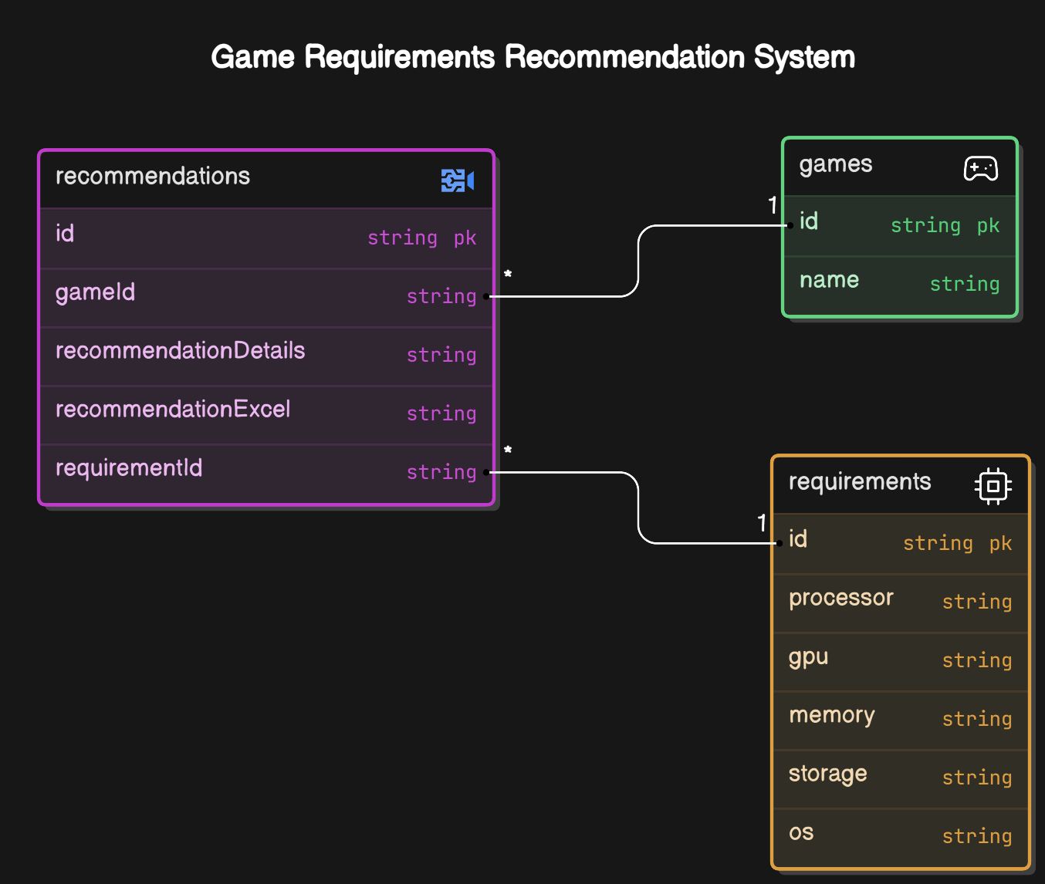
Table Design

Slide 11
Process Design
Main Process: Automates the end-to-end workflow of game requirement retrieval and storage.
Sub-Process 1: Fetch game requirements using UiPath and the RAWG API.
Sub-Process 2: Deserialize JSON responses and extract relevant fields.
Sub-Process 3: Write extracted data to an Excel sheet with appropriate formatting.

Slide 12
Implementation
Implementation
Module 1: Data Retrieval
Uses UiPath activities to send HTTP requests and receive JSON data.
Handles API key authentication and ensures secure communication.
Module 2: Data Storage
Employs UiPath workflows to process JSON data and map it to an Excel file.
Includes validation steps to check for missing or incomplete data entries.

Slide 13
Testing
Verification Steps:
Ensure that the RAWG API request returns valid JSON data for given game names.
Test JSON deserialization to confirm accurate data parsing.
Validate the Excel output for correctness and completeness of stored information.
Results:
Successful retrieval and storage of multiple game entries.
Error handling tested for invalid game names and network issues.

Slide 14
Conclusions
The "Game Requirements Recommendation System" offers a reliable and automated solution to the challenge of manually retrieving game compatibility information. By combining UiPath's robust automation capabilities with the extensive data provided by the RAWG API, the system achieves high efficiency, accuracy, and usability.So that user can know which PC parts he has to buy to play his Games.

Slide 15
Future Enhancement
Introduce support for batch processing to handle multiple game names
simultaneously.
Having a more user – friendly options in selecting games
Having to introduce a AI for giving most generic Parts Details for helping his/her Pcbuilding
Maybe Sending database excel file after a constant no of entries achieved as taken from user

Slide 16
References
RAWG Games Analysis: A project demonstrating an ETL pipeline for analyzing RAWG game data with JSON transformations and visualization. URL: https://github.com/jcgarciasis/RAWG_games_analysis
Rawr Get Results: A script to fetch game data from the RAWG API and update Excel spreadsheets with retrieved results. URL: https://github.com/ralmario/rawr_getresults
RawGames App: A game search application using the RAWG API, showing data retrieval and display workflows. URL: https://github.com/13paras/RawGames

Slide 17
Thank You

